Slide 3
Recap of Last Roundtable: Communicate for Success
Attendee Introductions
Today’s Roundtable: Dealing with Scarce Resources on Your Project
Session Wrap-Up

Slide 4
February Roundtable revisited: Communicate for Project Success

Slide 5
Project Life-Cycle for Today’s Discussion
Phase 1
Phase 2
Phase 3
Phase 4
Project Concept, Programming, Pre-Design
Schematic Design + Design Development
Preparation of Construction Documents + Bidding
Construction + Initial Operations/Occupancy
Includes Early Pre-Construction Services
Includes Pre-Construction Services and any Pre-Fab Decisions

Slide 6
Breakout Group 1 (Phase 1): Synopsis
Establish good forums for communication
Have a kick-off workshop
Set up early recurring meetings to build momentum
Develop/use Pre-Construction strategy to align expectations to reality
Drive helpful behaviors among stakeholders:
Courage to speak the truth
Forthrightness
Seek first to understand
Write a Project Charter
Use of Responsibility Assignment Matrices:
RAPID-type Chart: Identify the decisions to be made, who makes them, the information needed to make them, and who owns the risk by not doing so
Signs that this is working
Vulnerability
Measure it
Ensure all key stakeholders are involved
Recognize some stakeholders enter the project later than Phase 1

Slide 7
Breakout Group 2 (Phase 2): Synopsis
Create more effective meetings:
Conduct In-person meetings when possible
Be present in on-line meetings – turn on camera
Look to streamline Agenda – seek to clear Action Items
Come to each meeting prepared
Align ALL design team members with Owner
Use open communication with ALL Design Team and Owner
Team Leaders need to promote consistency in communication
Seek to promote Partnerships
Use Collaborative Technology
Such as BIM360, Bluebeam Studio
Avoid CYA postures
This kills collaboration

Slide 8
Breakout Group 3 (Phase 3): Synopsis
Carefully select Project Delivery Method
More collaborative: IPD and DB
Less collaborative: DBB, Hard Bid
Always be accountable
Always do what you say you will do
Effective Communication Techniques:
Lots of follow-up, questions, clarity of assumptions
Choice of message medium: Visuals/documents vs. conversations, or narrative only
Use MS-Teams to your advantage – virtual and in-person
Important Skills Needed:
Being able to articulate intent with drawing/sketch or other visual
Ability to clearly re-cap discussion and state high-level objectives
Ownership
Clarity of document revisions
Use of Pre-Award and Post-Award Meetings
Always follow up with new information

Slide 9
Breakout Group 4 (Phase 4): Synopsis
Use of Lean Construction Practices
Last Planner
“Plan of the Day” Meetings
“Putting Project First”
Use a Team Building or Partnering Session
Prioritize Meetings in Person
“Be Open” and Clear & Concise
Use Active Listening
Be open to constructive comments
Resist emotional response, especially when the news is not good
Look to Provide Solutions or Opportunities when Problems Arise
Check your Ego
Know when to be flexible, when to be firm

Slide 10
“Go To” Interpersonal or Communication Skill
Create Effective Team
Team building & establishing protocols
Build rapport through team building, getting to know the team members and their personalities
Coaching & mentoring
Promote collaboration
Emotional Intelligence
Get to know personalities
Seek to understand, first
“Clear is kind”
Comedic approach
Ask questions
Authenticity, Humor, Creativity
Availability
Delivery Forum or Venue
Talk in Person!!!
Meet someone where they are at.
Talk to the person directly.
In person discussions followed up with written summary
Effective Planning
Use of lean construction approaches
Engage all stakeholders in productive planning
Centrality for Information
Use regular project meetings
Ensure meeting minutes are thoroughly recording and use a specific file sharing service
Central place for communication

Slide 11
Today’s Roundtable:
Dealing with Scarce Resources on Your Project

Slide 12
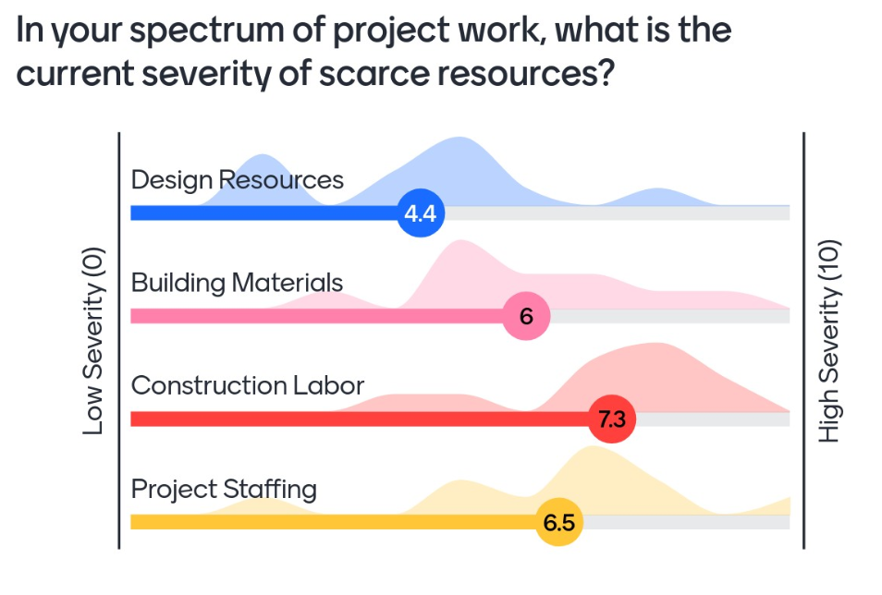
MentiMeter Survey: Question 1
There were 12 responses for this slide.
The most acute scarcity is construction labor.

Slide 13
MentiMeter Survey: Question 2
Survey indicates scarcity problems of:
Electrical equipment (generators, switchgear)
Skilled trades
Foremen

Slide 14
MentiMeter Survey: Question 3
Current view is that material shortage issues are here to stay for the foreseeable future – especially for electrical equipment

Slide 15
MentiMeter Survey: Question 4
Current view is that construction labor shortage issues are here to stay for the foreseeable future – much of this is due to the mega or major projects that are occurring in Ohio right now (Intel) or will be (Brent Spence Bridge).

Slide 16
MentiMeter Survey: Question 5
To cope with material shortages, the key strategies involve:
Purchasing items as early as possible
Identifying alternate designs or substitutes
Up-front planning
Work-arounds

Slide 17
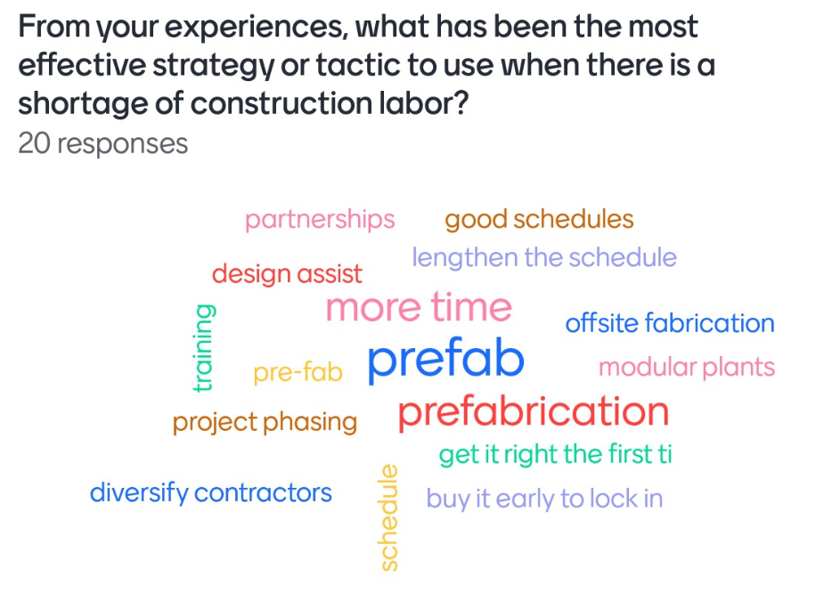
MentiMeter Survey: Question 6
To cope with construction labor shortages, the key strategies involve:
Moving work away from job site through pre-fabrication or modularization.
Establishing a longer target schedule to recognize the shortage.
Using design assist to define specific tactics to support a strategy.

Slide 18
Breakout Discussion
Understanding of scarcity issues as design evolves and project scope decisions are made
Sharing knowledge of current material scarcity and ways to cope with them
General “think tank” of possible new approaches
Tactics to consider when construction labor shortages are predicted
For each breakout group, seek to define best or better practices for each of these topics

Slide 19
MentiMeter Survey
What is biggest challenge facing your projects today?
Technology moving faster than industry and owners
Funding and interest rates
Risk management
Disconnect between owners and the reality of the industry currently.
Productivity / Diligence
Owner changes
Driving down costs
Owners make decisions in a timely manner.
Duration
Poor communication
Communication/collaboration during construction.
Bad budgets
Cost and scope alignment
Decarbonization

Slide 20
The open discussion.
Topic and lots of participation by attendees
It was nice to hear everyone opinions and ideas.
Ice breaker question
Discussion around prefab efforts
Relevant topic
Good conversation. Good topics. Good venue
The ideas discussed around labor and material shortages.
Conversation on labor resources and materials related to delays and project impact.
Format of the session. Good collaboration amongst peers from different roles.
Confirmation that others are experiencing similar issues.
Anonymous response opportunities
Enjoyed the meeting. Great to meet new people. More attendance next time.
More trades
More architects
Need owners!
Invite suppliers
[Need more] Diversity

Slide 21
Next SW Ohio Cogence Roundtable
June 6, 2024
The Kleingers Group Office
4:30pm to 6:00pm EDT

Slide 22
Save The Date!
September 12-13, 2024
Cogence Town Hall
Hilton Easton Town Center, Columbus

Slide 23
Cogence Alliance would like to honor the best in project collaboration, while showing our community how their contributions are improving project outcomes in the A/E/C industry.
The Cogence Drive Awards will highlight the critical role and immense value that collaboration and innovation bring to building projects.
Intent to Submit by July 15th
Entries due August 12th
COGENCE
DRIVE
AWARDS
^{Visit cogence.org/drive-awards}
^{for additional information}
Share with your marketing department

