Slide 3
Today’s Roundtable:
Emerging Trends and Best Practices for Design and Construction of Healthcare Projects

Slide 4
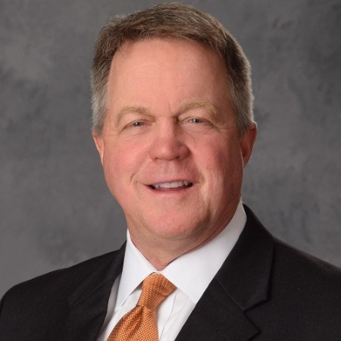
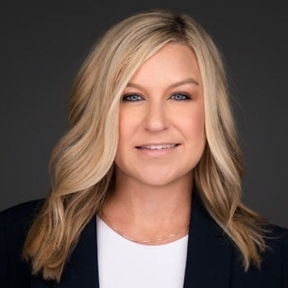
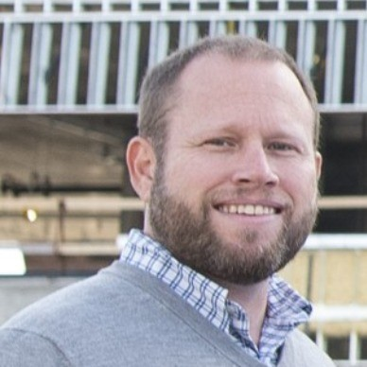
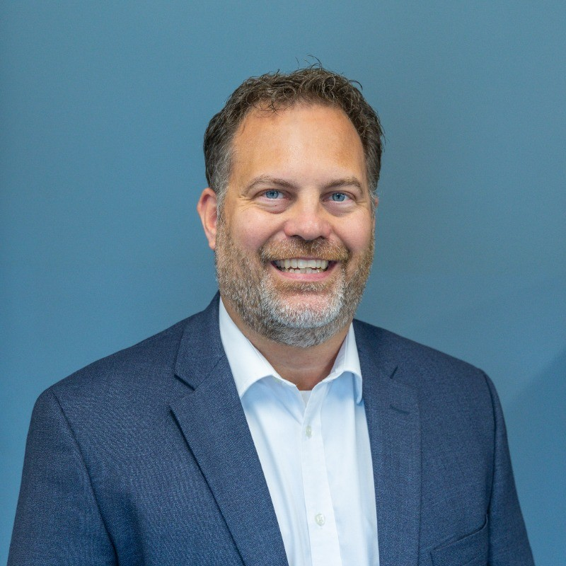
John A Brownrigg
System Director, Facility Planning/Construction/Real Estate
Premier Health
Anna Combs
Director, Design & Construction
Bon Secours Mercy Health
Aaron Greene
President
Hplex Solutions
Clint Mollere, MHA, CHFM
Director of Project Management
St. Elizabeth Healthcare

Slide 5
Mentimeter Survey Session
What are your key takeaways from today’s session?

Slide 6
Key Takeaways
Collaboration/Communication/Transparency
Trust/Build Spirit of Partnership
Assembling the “Right Team”/Contract Strategy
Technology
Better Practices
General Comments/Potpourri

Slide 7
Collaboration/ Communication/ Transparency
Collaboration is key
Delivery methods and communications. Collaboration
Transparent communication
Effective communication
Communication is key - across the team
Communication, collaboration and transparency
Transparency and openness are key
Owners, designers, and contractors have similar conditions of satisfaction on a project. The key is this communication to align or understanding.

Slide 8
Trust/Build Spirit of Partnership
Know who you’re working with
Trusted partners
Trust is key
Partnership is key.

Slide 9
Assembling the “Right Team”/Contract Strategy
Assembling the “Right Team”: The people matter more than the firm they’re from, project problems, etc.; It’s about the people and not the firm; Right teams make the project successful. Previous [good] performance is helpful. Everyone working to make better projects
RFP Process: RFP process needs innovation; Super elaborate RFP responses are not what win projects! It’s the team’s experience and their ability to deliver.; [Place] Priority on early bid packages; Develop an understanding of project priorities.

Slide 10
Technology
Technology and sustainability are big future factors of growth
Technology is very much the way of the future

Slide 11
Better Practices
KPI’s: Hearing the key performance indicators from the panel on the whole construction process
Pre-Construction Services: Pre-construction efforts are critical
Use of Standardization: Standardization may bring speed to market and controlled costs and quality

Slide 12
General Comments/ Potpourri
Benefits of Session: Hearing what is top of mind for owners, Being in a room with all good players, [Having] Experts in the room, Wide range of experience in the room
Great community overall and similar feedback of experiences in healthcare as experienced in other markets.
Behavioral Health is a priority
MEP needs to figure out sustainable solutions
Hospitals are looking at infrastructure upgrades for future work

Slide 13
Mentimeter Survey Session
Plus/Delta and Future Program Topics

Slide 14
Emerging Trends and Best Practices for Design & Construction of Health Care Construction Projects
Plus: What went well today?
Good or Great panel! (8)
Good questions (3)
Good dialogue (2)
Starting on time
Good back and forth
Room-easy to hear
Collaboration
Topics were on point
Great feedback
Great turn out. Good perspective.
Great content and great moderator!
Diverse group of registrants
Great environment
Great room and environment
Multiple and varied perspectives on the panel

Slide 15
Emerging Trends and Best Practices for Design & Construction of Health Care Construction Projects
Delta: What Didn’t Go So Well Today? Where Can We Improve?
Keep the discussion going
More scratch paper
Rain and it’s getting colder
Allow for more questions from the group
More time for audience?
Time was short
Some responses were hard to hear
More owners needed
How do we innovate together
More interactive
Less time for audience
Activity to encourage engagement
Technology and uses of AI
What defines a high performing building
More time to get beer before starting

Slide 16
What Topics Would You Like to Discuss at Future Roundtables:
Project-specific review
QA/QC
Tradesman shortage - impacts and understanding
What defines a high-performance building
Why utilize the various project delivery models
How owners balance program needs with budget and limited funds
Technology advances and showcase
TVD - how to do it successfully

